Slide 1
Advanced Algorithm
Design and Analysis (Lecture 5)
SW5 fall 2004
Simonas Šaltenis
E1-215b
simas@cs.aau.dk

Slide 2
Greedy Algorithms
Goals of the lecture:
  to understand the principles of the greedy algorithm design technique;
  to understand the example greedy algorithms for activity selection and Huffman coding, to be able to prove that these algorithms find optimal solutions;
  to be able to apply the greedy algorithm design technique.

Slide 3
Activity-Selection Problem
Input:
  A set of n activities, each with start and end times: A[i].s and A[i].f. The activity last during the period [A[i].s, A[i].f)
Output:
  The largest subset of mutually compatible activities
    Activities are compatible if their intervals do not intersect
8
2
5
9
1
3
6
4
7
Time
0 1 2 3 4 5 6 7 8 9 10 12 14 16 18 20 22

Slide 4
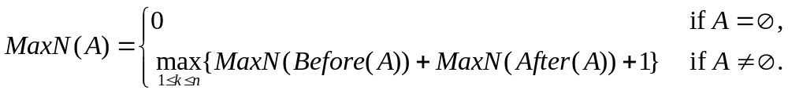
“Straight-forward” solution
Let’s just pick (schedule) one activity A[k]
  This generates two set’s of activities compatible with it: Before(k), After(k)
    E.g., Before(4) = {1, 2}; After(4) = {6,7,8,9}
  Solution:
8
2
5
9
1
3
6
4
7
Time
0 1 2 3 4 5 6 7 8 9 10 12 14 16 18 20 22

Slide 5
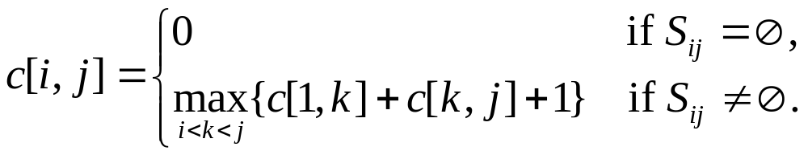
Dynamic Programming Alg.
The recurrence results in a dynamic programming algorithm
  Sort activities on the start or end time (for simplicity assume also “sentinel” activities A[0] and A[n+1])
  Let S_{ij} – a set of activities after A[i] and before A[j] and compatible with A[i] and A[j].
  Let’s have a two-dimensional array, s.t., c[i, j] = MaxN(S_{ij}).
  MaxN(A) = MaxN(S_{0,n+1}) = c[0, n+1]

Slide 6
Dynamic Programming Alg. II
Does it really work correctly?
  We have to prove the optimal sub-structure:
    If an optimal solution A to S_{ij} includes A[k], then solutions to S_{ik} and S_{kj} (as parts of A) must be optimal as well
    To prove use “cut-and-paste” argument
What is the running time of this algorithm?

Slide 7
Greedy choice
What if we could choose “the best” activity (as of now) and be sure that it belongs to an optimal solution
  We wouldn’t have to check out all these sub-problems and consider all currently possible choices!
Idea: Choose the activity that finishes first!
  Then, solve the problem for the remaining compatible activities
MaxN(A[1..n], i) //returns a set of activities
01 m ← i + 1
02 while m ≤ n and A[m].s < A[i].f do
03 m ← m + 1
04 if m ≤ n then return {A[m]} ∪ MaxN(A, m)
05 else return ∅

Slide 8
Greedy-choice property
What is the running time of this algorithm?
Does it find an optimal solution?:
  We have to prove the greedy-choice property, i.e., that our locally optimal choice belongs to some globally optimal solution.
  We have to prove the optimal sub-structure property (we did that already)
The challenge is to choose the right interpretation of “the best choice”:
  How about the activity that starts first
    Show a counter-example

Slide 9
Data Compression
Data compression problem – strings S and S’:
  S -> S’ -> S, such that |S’|<|S|
Text compression by coding with variable-length code:
  Obvious idea – assign short codes to frequent characters: “abracadabra”
  Frequency table:
  How much do we save in this case?
 | a | b | c | d | r
Frequency | 5 | 2 | 1 | 1 | 2
Fixed-length code | 000 | 001 | 010 | 011 | 100
Variable-length code | 1 | 001 | 0000 | 0001 | 01

Slide 10
Prefix code
Optimal code for given frequencies:
  Achieves the minimal length of the coded text
Prefix code: no codeword is prefix of another
  It can be shown that optimal coding can be done with prefix code
11
0
1
6
5
0
1
a
4
2
0
1
r
2
2
0
1
b
1
1
c
d
We can store all codewords in a binary trie – very easy to decode
  Coded characters in leaves
  Each node contains the sum of the frequencies of all descendants

Slide 11
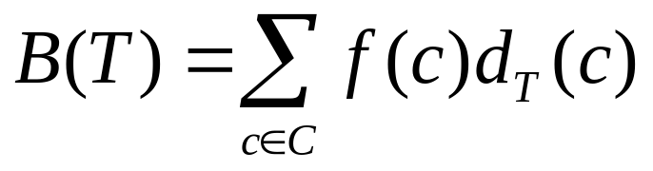
Optimal Code/Trie
The cost of the coding trie T:
  C – the alphabet,
  f(c) – frequency of character c,
  d_{T}(c) – depth of c in the trie (length of code in bits)
Optimal trie – the one that minimizes B(T)
Observation – optimal trie is always full:
  Every non-leaf node has two children. Why?

Slide 12
Huffman Algorithm - Idea
Huffman algorithm, builds the code trie bottom up. Consider a forest of trees:
  Initially – one separate node for each character.
  In each step – join two trees into a larger tree
A+B
0
1
A
B
A
B
  Repeat this until one tree (trie) remains.
  Which trees to join? Greedy choice – the trees with the smallest frequencies!

Slide 13
Huffman Algorithm
Huffman(C)
01 Q.build(C) // Builds a min-priority queue on frequences
02 for i ← 1 to n–1 do
03 Allocate new node z
04 x ← Q.extractMin()
05 y ← Q.extractMin()
06 z.setLeft(x)
07 z.setRight(y)
08 z.setF(x.f() + y.f())
09 Q.insert(z)
10 return Q.extractMin() // Return the root of the trie
What is its running time?
Run the algorithm on: “oho ho, Ole”

Slide 14
Correctness of Huffman
Greedy choice property:
  Let x, y – two characters with lowest frequencies. Then there exists an optimal prefix code where codewords for x and y have the same length and differ only in the last bit
  Let’s prove it:
    Transform an optimal trie T into one (T’’), where x and y are max-depth siblings. Compare the costs.

Slide 15
Correctness of Huffman
Optimal sub-structure property:
  Let x, y – characters with minimum frequency
  C’ = C –{x,y}∪{z}, such that f(z) = f(x) + f(y)
  Let T’ be an optimal code trie for C’
  Replace leaf z in T’ with internal node with two children x and y
  The result tree T is an optimal code trie for C
Proof a little bit more involved than a simple “cut-and-paste” argument

Slide 16
Elements of Greedy Algorithms
Greedy algorithms are used for optimization problems
  A number of choices have to be made to arrive at an optimal solution
  At each step, make the “locally best” choice, without considering all possible choices and solutions to sub-problems induced by these choices (compare to dynamic programming)
  After the choice, only one sub-problem remains (smaller than the original)
Greedy algorithms usually sort or use priority queues

Slide 17
Elements of Greedy Algorithms
First, one has to prove the optimal sub-structure property
  the simple “cut-and-paste” argument may work
The main challenge is to decide the interpretation of “the best” so that it leads to a global optimal solution, i.e., you can prove the greedy choice property
  The proof is usually constructive: takes a hypothetical optimal solution without the specific greedy choice and transforms into one that has this greedy choice.
  Or you find counter-examples demonstrating that your greedy choice does not lead to a global optimal solution.

Slide 18
Other Greedy Algorithms
Find a minimum spanning tree in a weighted graph
Coin changing

